Slide 1
Approaches to Query Optimization
Bowen Zhang

Slide 2
Outline
About Reinforcement Learning
Some View towards Query Optimization
ReJoin
Learning States Representation
Neo

Slide 3
Characteristics of Reinforcement Learning
What makes reinforcement learning different from other machine learning paradigms?
There is no supervisor, only a reward signal Feedback is delayed, not instantaneous
Time really matters (sequential, non i.i.d data) Agent’s actions affect the subsequent data it receives

Slide 4
Rewards
A reward R_{t} is a scalar feedback signal Indicates how well agent is doing at step t
The agent’s job is to maximise cumulative reward
Reinforcement learning is based on the reward hypothesis
Definition (Reward Hypothesis)
All goals can be described by the maximisation of expected cumulative reward

Slide 5
Sequential Decision Making
Goal: select actions to maximise total future reward
Actions may have long term consequences Reward may be delayed
It may be better to sacrifice immediate reward to gain more long-term reward
Examples:
A financial investment (may take months to mature) Refuelling opponent moves (might help winning chances many moves from now)

Slide 6
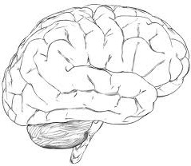
Agent and Environment
observation
action
O_{t}
A_{t}
reward
R_{t}

Slide 7
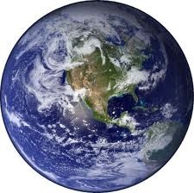
Agent and Environment
observation
action
At each step t the agent: Executes action A_{t} Receives observation O_{t} Receives scalar reward R_{t}
The environment:
Receives action A_{t}
Emits observation O_{t+1}
Emits scalar reward R_{t+1}
t increments at env. step
O_{t}
A_{t}
reward
R_{t}

Slide 8
History and State
The history is the sequence of observations, actions, rewards
H_{t} = O₁, R₁, A₁, ..., A_{t−1}, O_{t} , R_{t}
i.e. all observable variables up to time t
i.e. the sensorimotor stream of a robot or embodied agent What happens next depends on the history:
The agent selects actions
The environment selects observations/rewards
State is the information used to determine what happens next Formally, state is a function of the history:
S_{t} = f (H_{t} )

Slide 9

Environment State
The environment state S_{t}^{e} is the environment’s private representation
i.e. whatever data the environment uses to pick the next observation/reward
The environment state is not usually visible to the agent
observation
action
O_{t}
A_{t}
reward
R_{t}
Even if S_{t}^{e} is visible, it may contain irrelevant
information
e
environment state S_{t}

Slide 10

Agent State
The agent state Sª is the
agent state Sª
agent’s internal representation
t
observation
action
i.e. whatever information the agent uses to pick the next action
i.e. it is the information used by reinforcement learning algorithms
It can be any function of history:
O_{t}
A_{t}
reward
R_{t}
Sª = f (H_{t} )
t

Slide 11
Major Components of an RL Agent
An RL agent may include one or more of these components:
Policy: agent’s behaviour function
Value function: how good is each state and/or action Model: agent’s representation of the environment

Slide 12

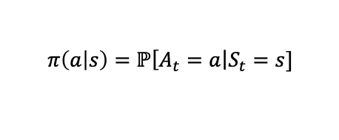
Policy
A policy is the agent’s behaviour
It is a map from state to action, e.g. Deterministic policy:
Stochastic policy:
$$a=π\left(a | s\right)$$
$$π\left(a | s\right)=ℙ\left[A_{t}=a\right.\left|S_{t}=s\right.]$$

Slide 13
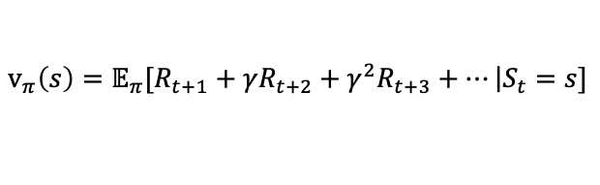
Value Function
Value function is a prediction of future reward Used to evaluate the goodness/badness of states And therefore to select between actions, e.g.
$$v_{π}\left(s\right)=𝔼_{π}[R_{t+1}+γR_{t+2}+γ^{2}R_{t+3}+…\left|S_{t}=s\right.]$$

Slide 14
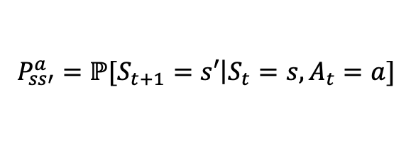
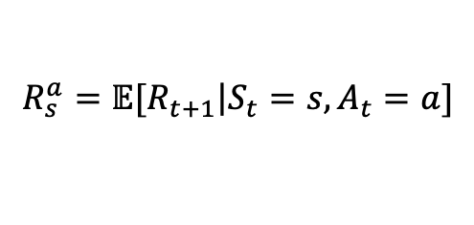
Model
A model predicts what the environment will do next
P predicts the next state
R predicts the next (immediate) reward, e.g.
$$P_{ss′}^{a}=ℙ[S_{t+1}=s′\left|S_{t}=s,A_{t}=a\right.]$$
$$R_{s}^{a}=𝔼[R_{t+1}\left|S_{t}=s,A_{t}=a\right.]$$

Slide 15

Maze Example
Start
Rewards: -1 per time-step Actions: N, E, S, W States: Agent’s location
Goal

Slide 16
Maze Example: Policy
Start
Goal
Arrows represent policy π(s) for each state s

Slide 17
Maze Example: Value Function
 | -14 | -13 | -12 | -11 | -10 | -9
-16 | -15 |  |  | -12 |  | -8
 | -16 | -17 |  |  | -6 | -7
 |  | -18 | -19 |  | -5
 | -24 |  | -20 |  | -4 | -3
 | -23 | -22 | -21 | -22 |  | -2 | -1
Start
Goal
Numbers represent value v_{π} (s) of each state s

Slide 18
Maze Example: Model
 | -1 | -1 -1 | -1 | -1 | -1
-1 | -1 |  | -1 |  | -1
 | -1 |  |  | -1 | -1
 |  |  |  | -1
 |  |  |  | -1 | -1
 |  |  |  |  | -1 | -1
Agent may have an internal model of the environment
Dynamics: how actions change the state
Rewards: how much reward
Start
from each state
The model may be imperfect
Goal
Grid layout represents transition model P
a ss'
a
Numbers represent immediate reward R from each state s
s
(same for all a)

Slide 19
Problematic properties of existing optimization systems
They are, or are composed of, carefully tuned and complex heuristics designed using many years of developer- based experience.
They take a “fire and forget ” approach, hence query optimizers are prevented from systematically “learning from their mistakes.”
Solution: Deep Reinforcement learning

Slide 20

Research Directions
Learning From Demonstration
1.1 A large query workload, W, is executed one query q at a time. Each q ∈ W is transformed by the traditional query optimizer into a physical plan through a number of actions a_{i} at various intermediary states s_{i}. which are recorded as an episode history:
1.2 The resulting physical plans are executed, and the la- tency of each query q ∈ W , L_{q} , is measured and saved.

Slide 21
Research Directions
Learning From Demonstration
1.3 Next, the agent is trained, for each q ∈ W, on the H_{q} and L_{q} data. Specifically, for each action/state pair (a_{i} , s_{i} ) ∈ H_{q} , the agent is taught to predict that taking action ai in state s_{i} eventually results in a query latency of L_{q}.
1.4 Once the agent has proficiency guessing the outcome of the traditional optimizer’s actions, the agent can fine tune itself.

Slide 22
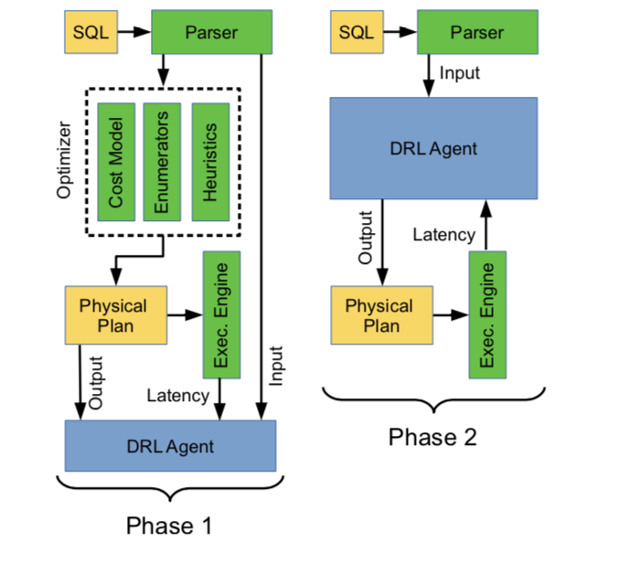
Research Directions
Learning From Demonstration

Slide 23
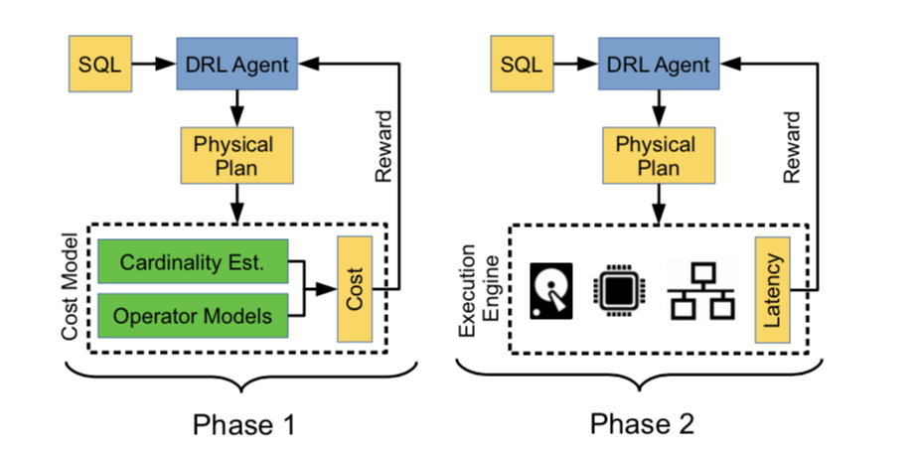
Research Directions
Cost Model Bootstrapping

Slide 24
Research Directions
Cost Model Bootstrapping
Why: There are already some good cost models and let the training converge easier.
Problem: May cause exploring previous discarded plans.
Solution: Choose cost plans close to Latency/ Converge Latency to cost plan

Slide 25
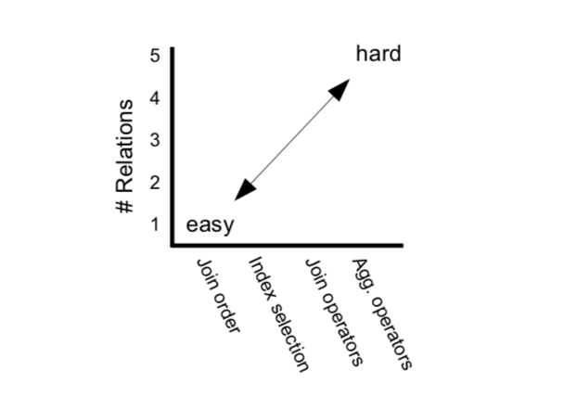
Research Directions
Incremental learning
first training a model to handle
simple cases and slowly
introducing more complexity.
Complexity Diagram

Slide 26
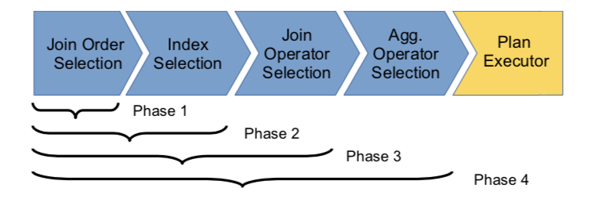
Research Directions
3.1 Increasing optimization actions (pipeline)
Drawbacks:
Each phase of the training process will not bring about a uniform increase in complexity.
The early training phases requires access to a traditional implementation of the later stages of the query optimization pipeline.

Slide 27
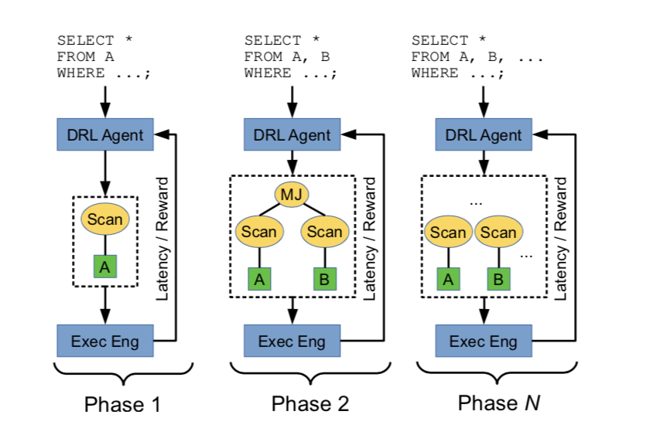
Research Directions
3.2 Increasing relations
Challenge:
How to find candidate query?

Slide 28
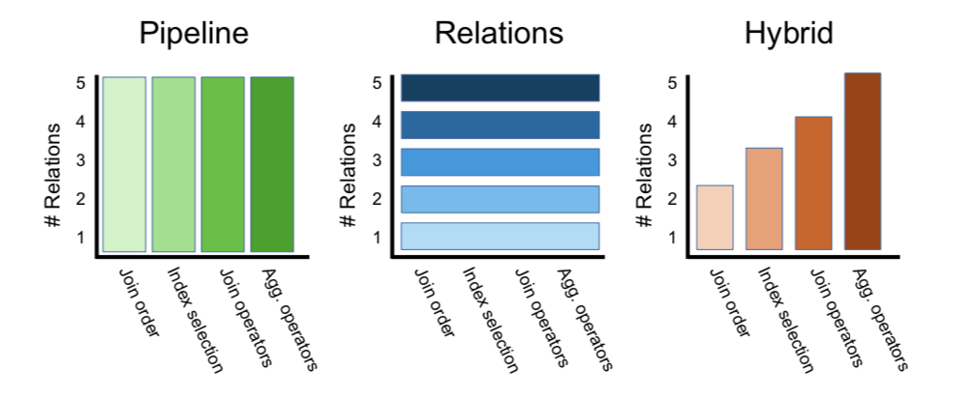
Research Directions
3.3 Hybrid
A combination of the previous two approaches
Suffers disadvantage from both two

Slide 29
Research Challenges
Search base size
Cases for DRL research are based on assuming query in limit form, but query can be various.
Performance indicator
Metric for query optimization may not be good.
Performance Evaluation Overhead
Calculate reward needs time.

Slide 30
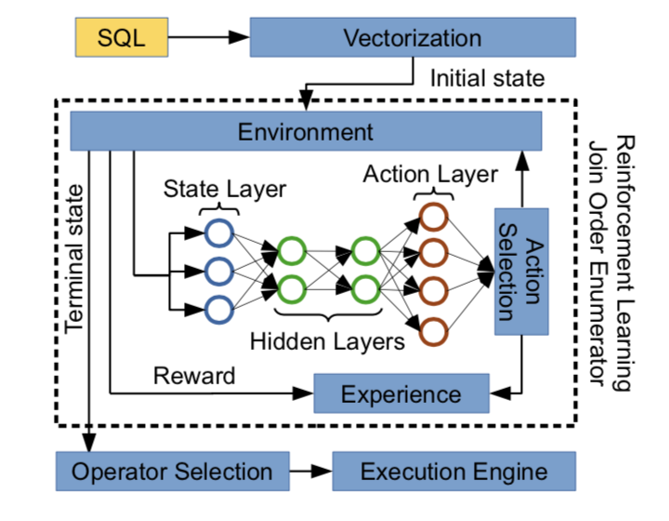
ReJOIN
1. Framework

Slide 31
ReJOIN
Reinforcement Learning Setup
Each query represents an episode.
Each state will represent subtrees of a binary join tree
Each action will represent combining two subtrees together
The episode ends when all input relations are joined (a terminal state). Reward assigned to the final join ordering based on the optimizer’s cost model.

Slide 32
ReJOIN
Enumerator methods
3.1 State Vectors
3.1.1 Tree Structure
3.1.2 Join Predicates
3.1.3 Selection Predicates

Slide 33
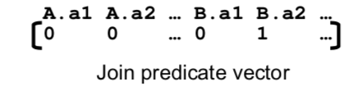
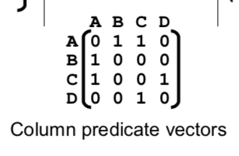
ReJOIN
Example:

Slide 34
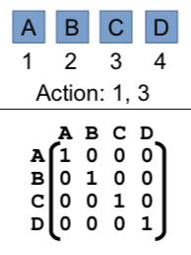
ReJOIN
Example:
Tree Vectors

Slide 35
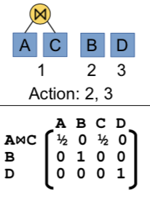
ReJOIN
Example:
Tree Vectors

Slide 36
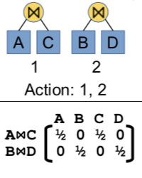
ReJOIN
Example:
Tree Vectors

Slide 37
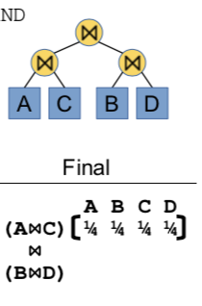
ReJOIN
Example:

Slide 38
ReJOIN
3.2 Reinforcement learning
3.2.1 Policy gradient
Given a state s_{t} and an action set A_{t} , the policy π_{θ} outputs a score for each action in A_{t}. Reinforcement learning aims to optimize the policy π_{θ} over episodes, i.e., to identify the policy parameters θ that optimizes the expected reward J_{π}(θ ) policy gradient methods search for the optimal policy parameters by constructing an estimator E of the gradient of the reward: E(θ) ≈ ∇_{θ}J_{π}(θ).

Slide 39
ReJOIN
3.2 Reinforcement learning
3.2.2 Policy gradient deep learning
Policy gradient deep learning methods represent the policy π_{θ} as a neural network, where θ is the network weights, thus enabling the efficient differentiation of π_{θ.}

Slide 40
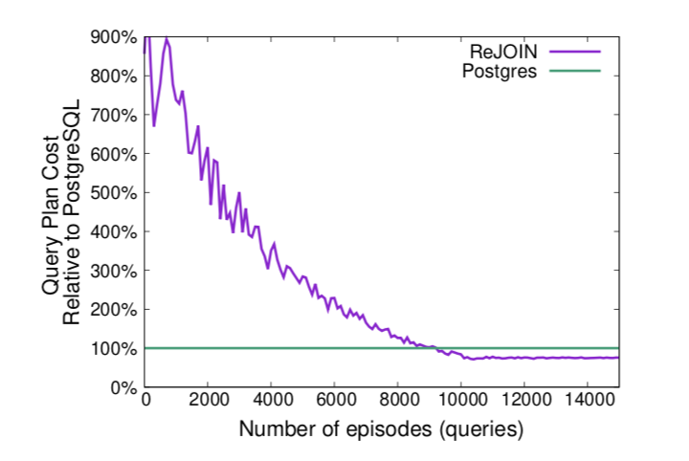
ReJOIN
5. Results

Slide 41
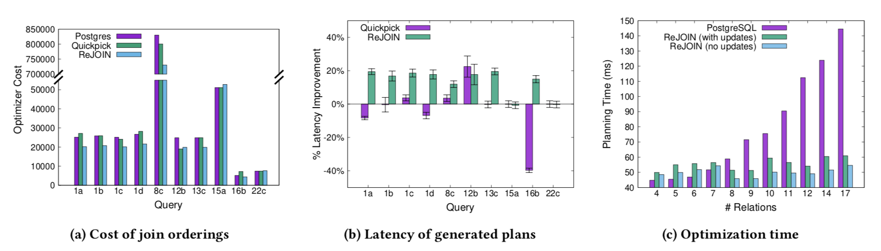
ReJOIN
5. Results

Slide 42
ReJOIN
Challenges
Latency optimization:
ReJOIN uses cost models depend on cardinality estimates, which are often error-prone.
End-to-end optimization:
ReJOIN only handles join order selection

Slide 43
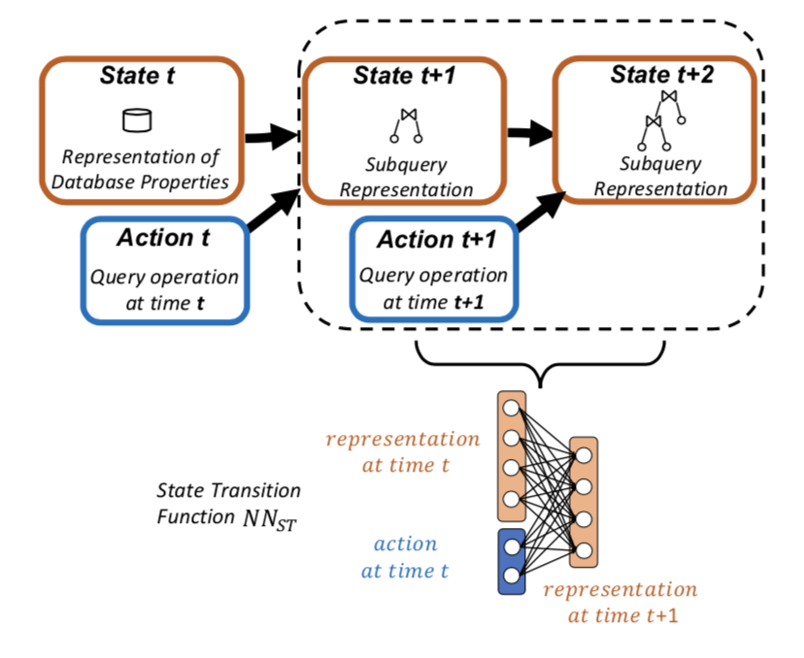
Learning States Representation
1. Framework

Slide 44
Learning States Representation
Framework
State: Stores Subquery representation, can serve for cardinality estimation and more importantly, for building optimal query plans using reinforcement learning.
Action: Query operation at time t.

Slide 45
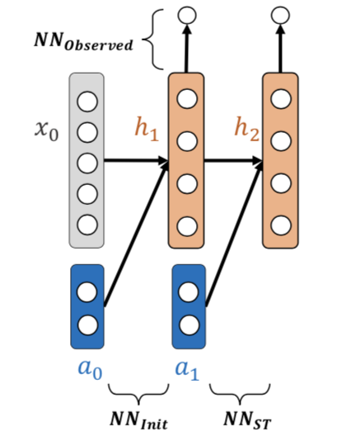
Learning States Representation
2. Model Training

Slide 46
Learning States Representation
Reinforcement Learning Setup
Initially, all state-action pairs are random values.
At each timestep, the agent selects an action (usually based on an ε -greedy policy) and observes the reward, r_{t+1} at state s_{t+1}.
As the agent explores the search space, these state-action pairs will converge to represent the expected reward of the states in future timesteps.
We compute the subsequent state given the state transition function, NN_{ST}.
Uses the negative of cardinality as reward or something else

Slide 47
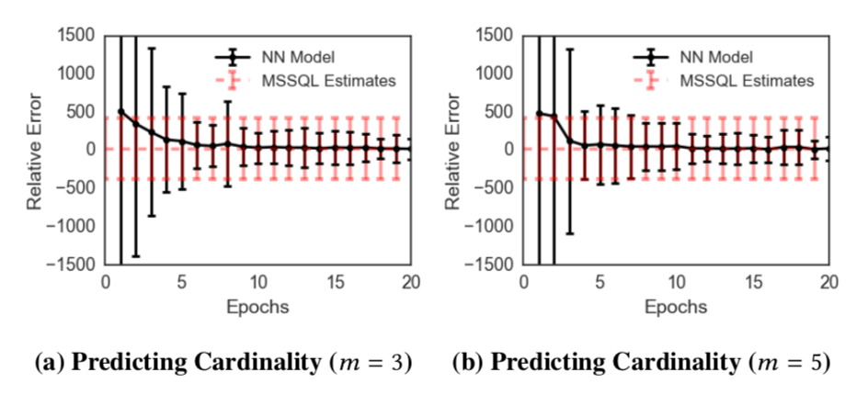
Learning States Representation
4. Results

Slide 48
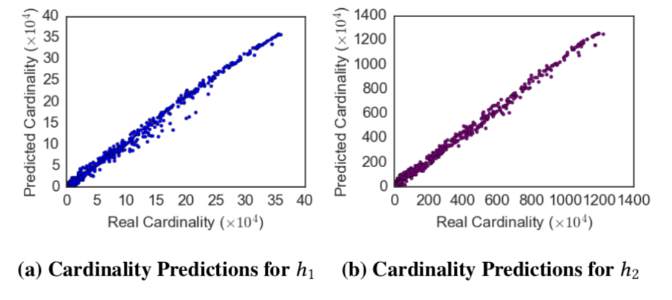
Learning States Representation
4. Results

Slide 49
Learning States Representation
Challenges
the choice of reward function and its impact on query plan selection
state-space is large, this paper only consider join and selections.

Slide 50
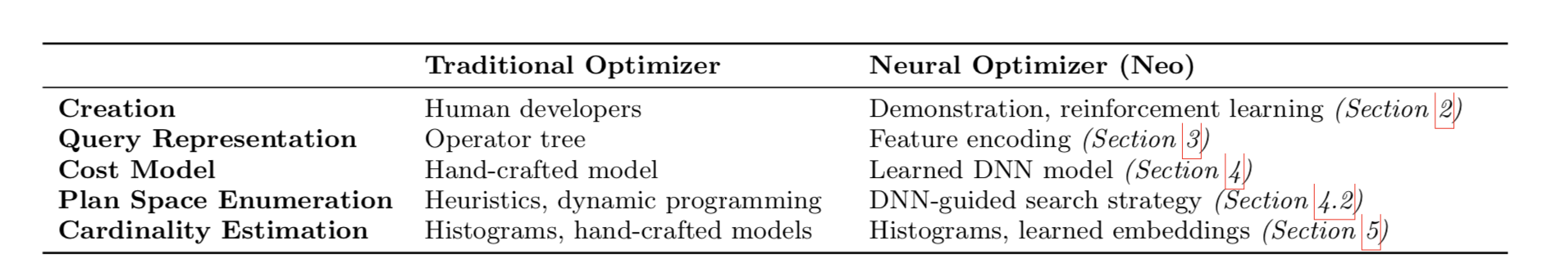
Neo
Why we use this
none of the recent machine-learning-based approaches come close to learning an entire optimizer, nor do they show how their techniques can achieve state-of-the- art performance (to the best of our knowledge, none of these approaches compare with a commercial optimizer).

Slide 51
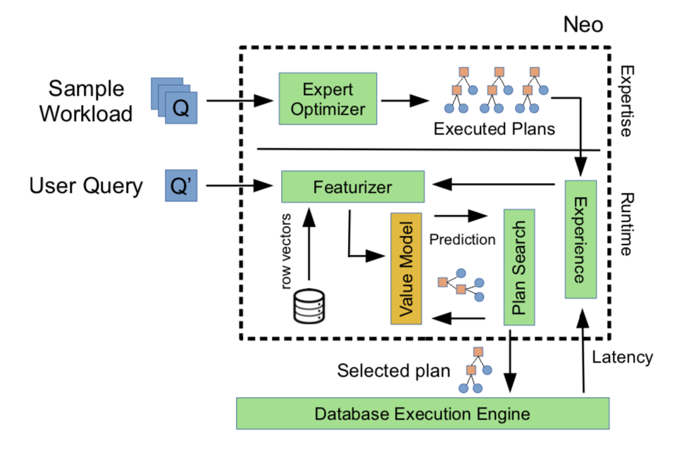
Neo
Framework

Slide 52
Neo
Framework
Expertise: Initially generates experience from a traditional query optimizer
Experience: Get query execution plans and latency from Expertise
Value model: a deep neural network with an architecture designed to predict the final execution time of a given partial or complete plan for a given query.
Plan search:Once query-level information has been en- coded, Neo uses the value model to search over the space of QEPs and discover the plan with the minimum predicted execution time.

Slide 53
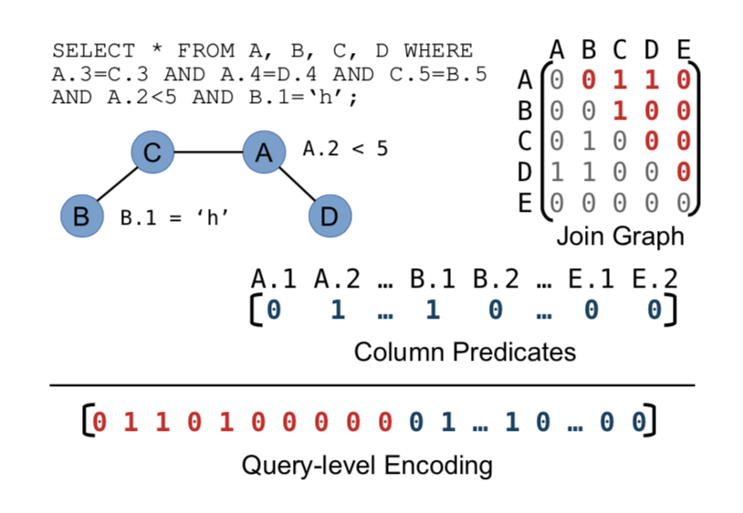
Neo
Encoding Method—Query level

Slide 54
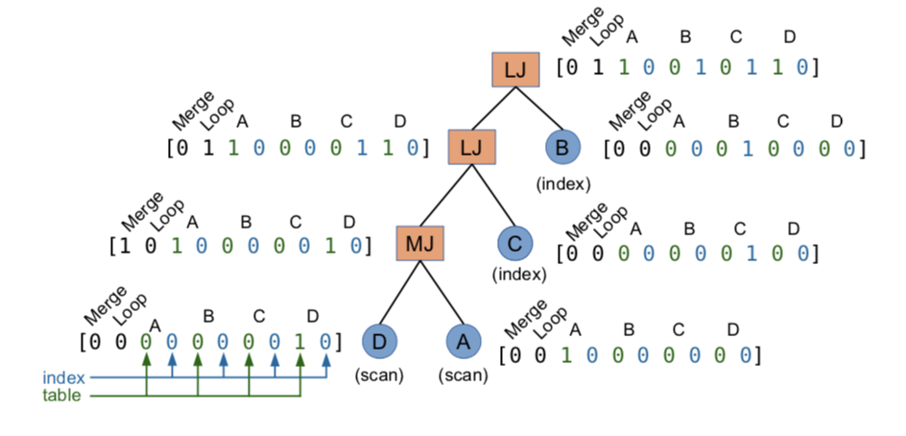
Neo
Encoding Method—Plan level

Slide 55
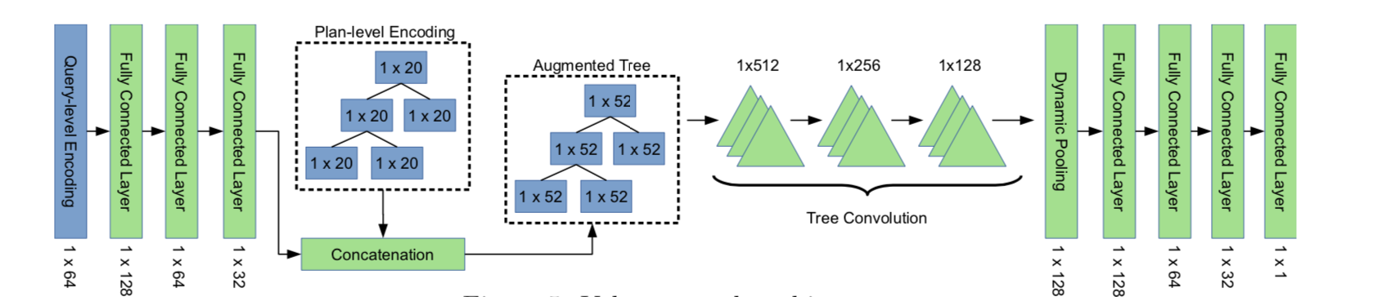
Neo
Value Network setting

Slide 56
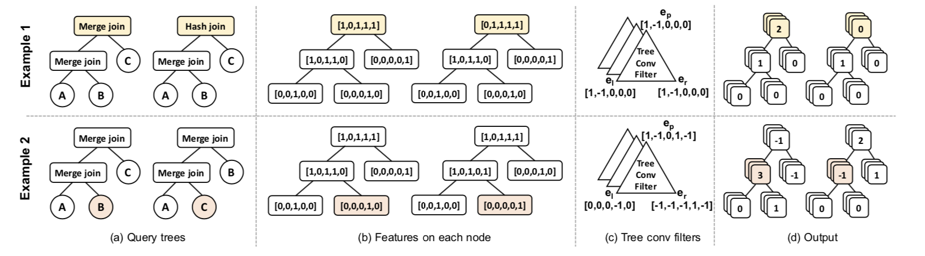
Neo
Tree Convolution

Slide 57
Neo
DNN-Guided Plan Search
the value network does not predict the cost of a subplan, but rather the best possible latency achievable from an execution plan that includes a given subplan.
The search process for query q starts by initializing an empty min heap to store partial execution plans. This min heap is ordered by the value network’s estimation of a partial plan’s cost. Then, a partial execution plan with an unspeci- fied scan for each relation in R(q) is added to the heap.

Slide 58
Neo
DNN-Guided Plan Search
At each search iteration, the subplan Pi at the top of the min heap is removed. We enumerate all of Pi’s children, Children(Pi), scoring them using the value network and adding them to the min heap.
While one could terminate this search process as soon as a leaf node (a complete execution plan) is found, this search procedure can easily be transformed into an anytime search algorithm [64], i.e. an algorithm that continues to find better and better results until a fixed time cutoff.

Slide 59
Neo
Row Vector Construction
1. One-hot encoding of the comparison operators (e.g. equal or not equal to)
2. Number of matched words
3. Column embedding generated by word2vec (100 val- ues, in our experiments)
4. Number of times the given value is seen in the training

Slide 60
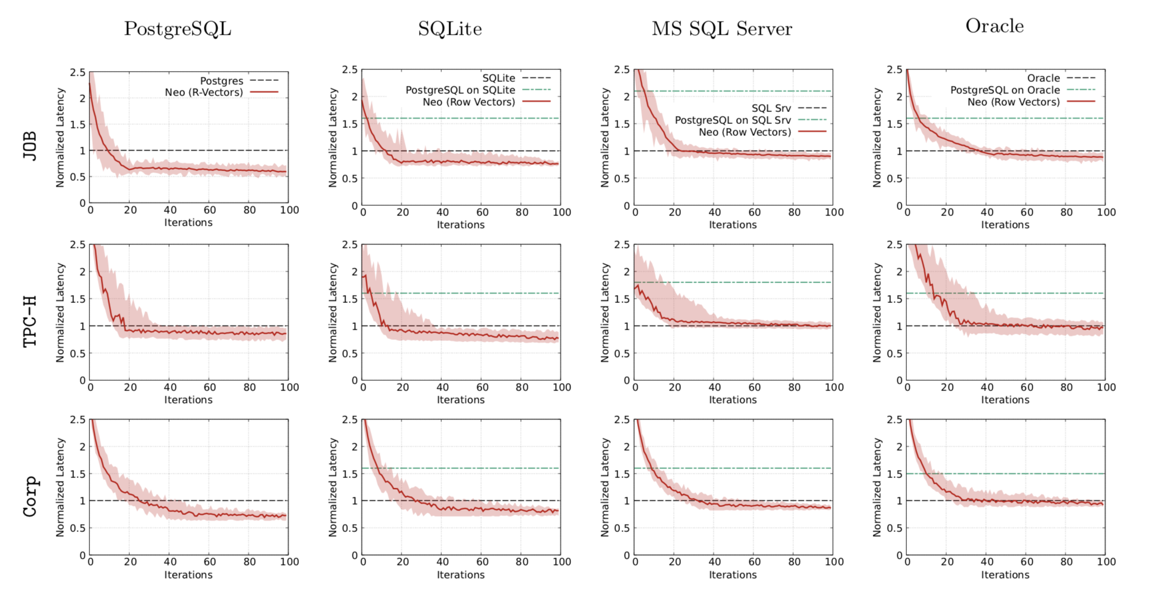
Neo
Row Vector Construction

Slide 62
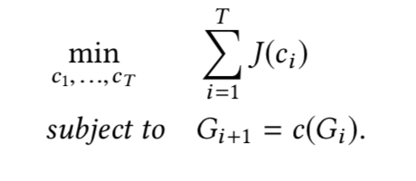
DQ
Problem Setting
Definition (Query Graph). A query graph G is an undirected graph, where each relation R is a vertex and each join predicate ρ defines an edge between vertices. Let κG denote the number of connected components of G.
Problem (Join Optimization Problem). Let G define a query graph and J define a cost model. Find a sequence c1 ◦ c2... ◦ cT terminating in |V | = κG to minimize:

Slide 63
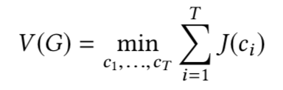







DQ
How is Reinforcement learning applied
Our goal:
Per join:
Q-function:
Parameterized version of Q function:
“estimated” Q-value:
Actuall Q-function:
The loss of each iteration:

Slide 64
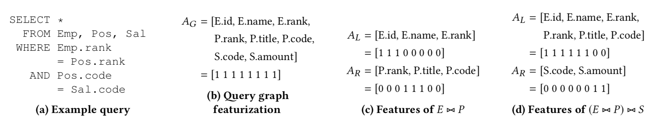
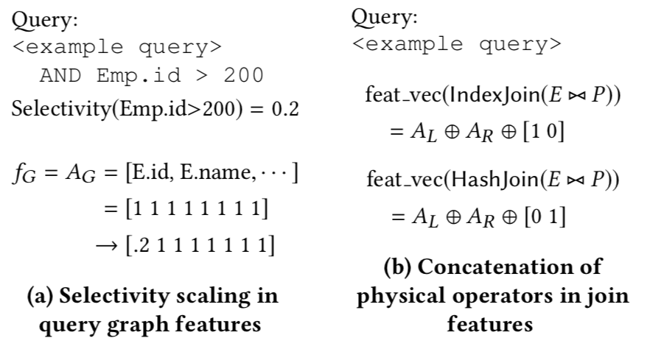
DQ
Featurizing Join Decision

Slide 65
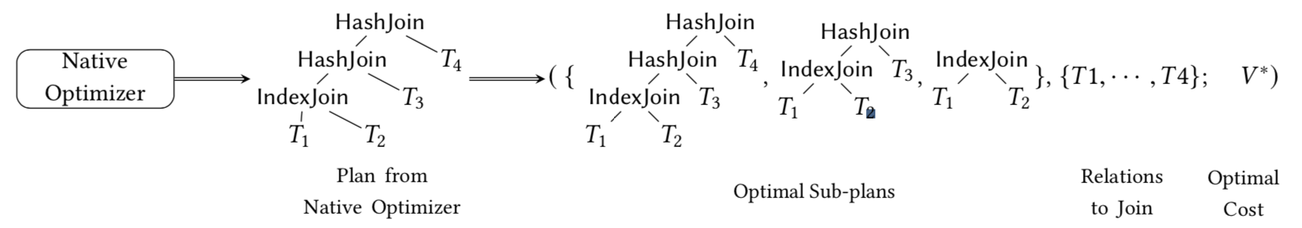
DQ
Training Data Collection

Slide 66
DQ
Execution after training
start with the query graph
featurize each join
find the join with the lowest estimated Q-value (i.e., output from the neural net)
update the query graph and repeat.

Slide 67
Reference:
Towards A Hands Free Query Optimizer with Deep Learning, CIDR 2019
NEO: A Learned Query Optimizer
Learning State Representations for Query Optimization With Deep Reenforcement Learning DEEM 2018
Deep Reinforcement Learning for join order enumeration aiDM 2018
Slides from Prof. David Silver http://www0.cs.ucl.ac.uk/staff/d.silver/web/Teaching_files/intro_RL.pdf

Slide 68
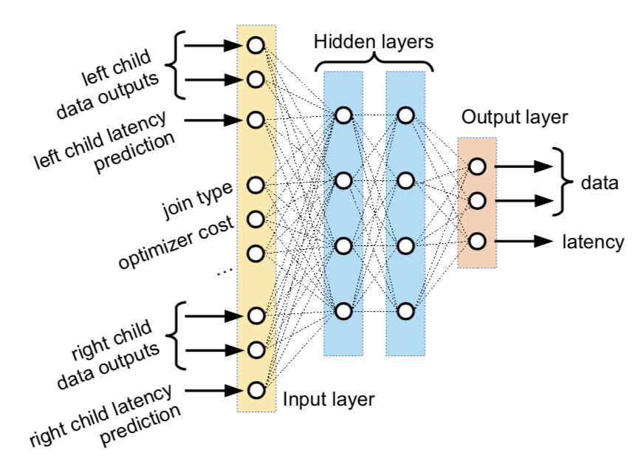
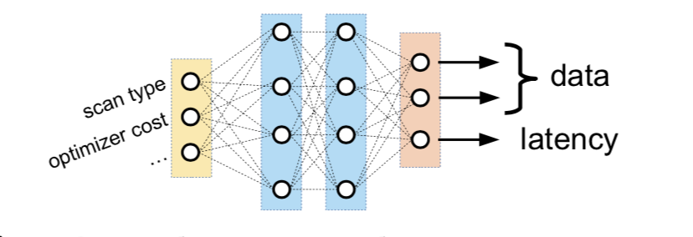
Plan-Structured Deep Neural Network
Deep Neural Network for join query

Slide 69
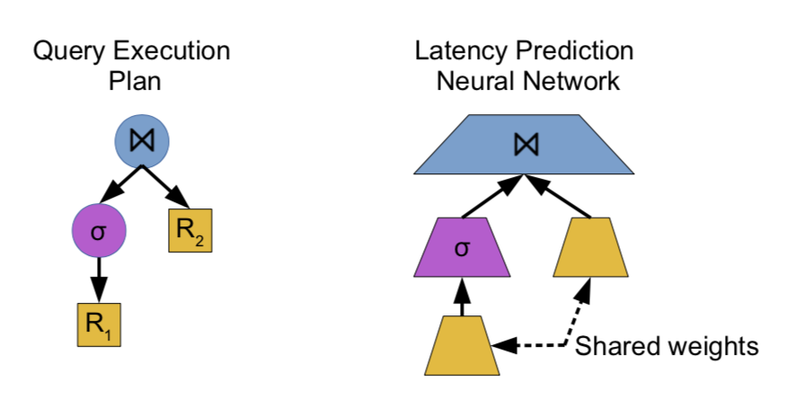
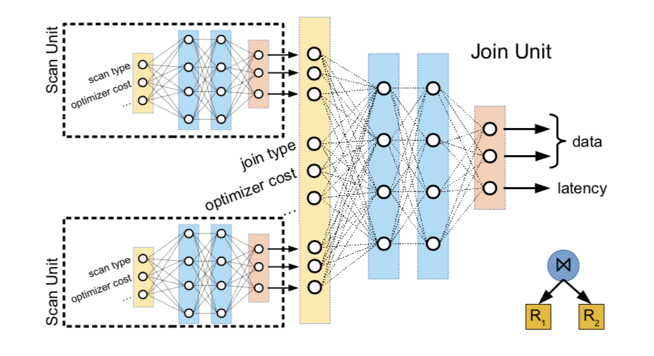
Plan-Structured Deep Neural Network
Deep Neural Network for join query

